Slide 1
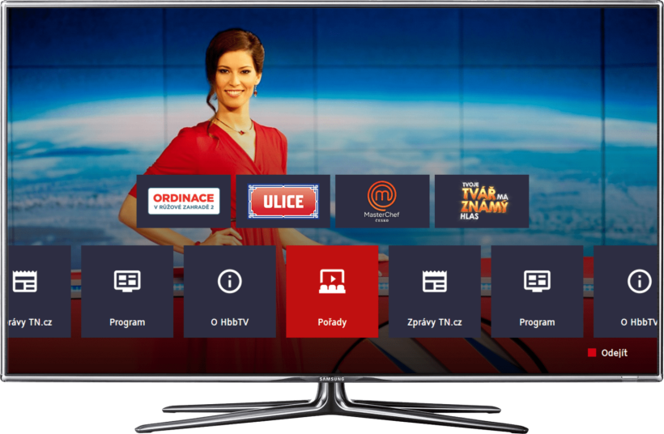

HbbTV - Apps
by
Shunmuga Sundaram Ponniah

Slide 2
App Groups
TestSuite
Shopping
Weather
3rd Party Portals
VoD
Music
Kids
Sports
Games
News
EPG
Teletext

Slide 3



TestSuites
http://itv.mit-xperts.com/hbbtvtest/index.php
http://hbbtv-live.irt.de:8080/redngreen

Slide 4


TestSuites
http://hbbtv-live.irt.de:8080/ssfdemo/
http://tv-html.irt.de/hbbtv/tests/lifecycle/lifecycle.php?app=App1

Slide 5



3rd Party Portal
http://web.ard.de/hbbtv-portal/index.php?link=hbbig
http://hbbtv01p.anixe.net/pub/dasvierte/portal/appPortal.php

Slide 6


3rd Party Portal
http://www.zeelandnet.nl/hbbtv-acc/index.php?
http://tv.mytvscout.de/mytvscout/

Slide 7


Shopping
http://tenfoot.jaast.com/smart/start.php

Slide 8


Weather
http://nettv.foreca.com/index.php?letmein=1

Slide 9



Teletext
http://teletext.ok54.de/hbbtv.php
http://hbbtv.wdr.de/wdrtext/

Slide 10


Teletext
http://orfhbbtv.orf.apa.net/orf/teletext/index.html?id=teletext&ref=portal
http://hbbtv.puls4.com/

Slide 11



EPG
http://tilden.rovicorp.com/CE-HTML-EPG/HTTV74687/120_b/
http://itv.ard.de/ardepg/index.php

Slide 12

EPG
http://www.arte.tv/hbbtvv2/index.html?lang=fr_FR&page=PLUS7&tv=true

Slide 13



News
http://www.euronews.com/_partners/philips/#de
http://tv.mytvscout.de/pcwelt/

Slide 14


News
http://philips.playintv.com/portal/france24/application.cehtml
http://www.tagesschau.de/itv/hbbtv/hbbtv.cehtml

Slide 15



Games
http://hbbig.itsmy.tv/spielecenter/
http://rc.mineus.cz/pong/tv/index.html

Slide 16

Games
http://zeelandnet.itsmy.tv/spielecenter/games/poker/index.php?x-backlink=http%3A%2F%2Fwww.zeelandnet.nl%2Fhbbtv%2Findex.php&x-backlink-label=Afsluiten

Slide 17

Games
http://zeelandnet.itsmy.tv/spielecenter/games/sudoku/index.php?x-backlink=http%3A%2F%2Fwww.zeelandnet.nl%2Fhbbtv%2Findex.php&x-backlink-label=Afsluiten

Slide 18

Games
http://zeelandnet.itsmy.tv/spielecenter/games/pairs/index.php?x-backlink=http%3A%2F%2Fwww.zeelandnet.nl%2Fhbbtv%2Findex.php&x-backlink-label=Afsluiten

Slide 19

Games
http://zeelandnet.itsmy.tv/spielecenter/games/blobbyszaubermine/index.php?x-backlink=http%3A%2F%2Fwww.zeelandnet.nl%2Fhbbtv%2Findex.php&x-backlink-label=Afsluiten

Slide 20

Games
http://zeelandnet.itsmy.tv/spielecenter/games/solitaire/index.php?x-backlink=http%3A%2F%2Fwww.zeelandnet.nl%2Fhbbtv%2Findex.php&x-backlink-label=Afsluiten

Slide 21



Sports
http://sportdigital.services.nrmmh.tv/
http://hbbtv.zdf.de/olympia/?design=1

Slide 22


Kids
http://smarttv.rbb-online.de/hbbtv/sandmann/index.php?broadcaster=kika

Slide 23



Music
http://www3.iconcerts.com/?q=en/netTV
http://ce.radiotime.com/

Slide 24

VoD
Yet to add

Slide 25
All-in-One
https://github.com/shunmugasundaramp/hbbtv_testapp/tree/master/portal

Slide 26
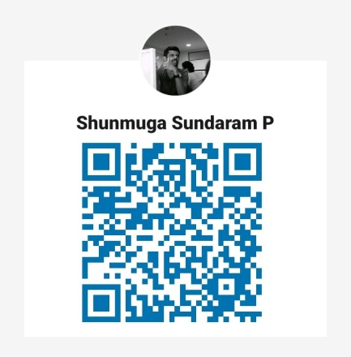
Thank You !!!
Please write your suggestions or queries to
ssundaramp@outlook.com

